Slide 1

Python dictionaries
Motivation
What are they?
Syntax
Methods
Operations
Looping
Dr. Tateosian
Notes:
We have already used several Python built-in data types, including integers, floats, strings, lists, tuples, sets, and Booleans. Now we're going to add another handy data type called a dictionary to our toolbelts. We'll start with some reasons dictionaries are useful in the geospatial realm before looking at how to use them.

Slide 2

Geospatial Pairs
City Name and Population:
City: Los Angeles
Population: 3,898,747
Feature ID and Geometry:
Feature ID: 12345
Geometry: (POINT (34.0522 -118.2437))
Municipality Name and Admin. Region:
Municipality: New York City
Region: New York State
UTM Zone and Zone Description:
UTM Zone: 33T
Zone Description: UTM Zone 33T, Europe
Notes:
Dictionaries are a way to store elements that belong together. Specifically, they store key-value pairs.
Geospatial applications with paired information abound.
For example, a dataset may report a population for each city.
A geometry can be stored for each feature ID.
And a municipality has an administrative region.
Can you think of any other examples of paired geospatial information?
ISO code:country name feature layer:symbology county fips code: county name EPSG: projection name

Slide 3

Geospatial Pairs
US State Abbreviation and Capital City:
State Abbreviation: CA
Capital City: Sacramento
Weather Station ID and Weather Data:
Station ID: 123456
Weather Data: Temperature: 25°C, Humidity: 55%
Land Use Code and Land Use Type:
Land Use Code: 110
Land Use Type: Residential
Geospatial Dataset Name and Description:
Dataset Name: World Roads
Description: Highways and major roads dataset covering the globe.
Watershed Name and Area:
Watershed Name: Mississippi River Basin
Area: 3,203,618 square kilometers
Notes:
Stumped? Here are a few more!

Slide 4
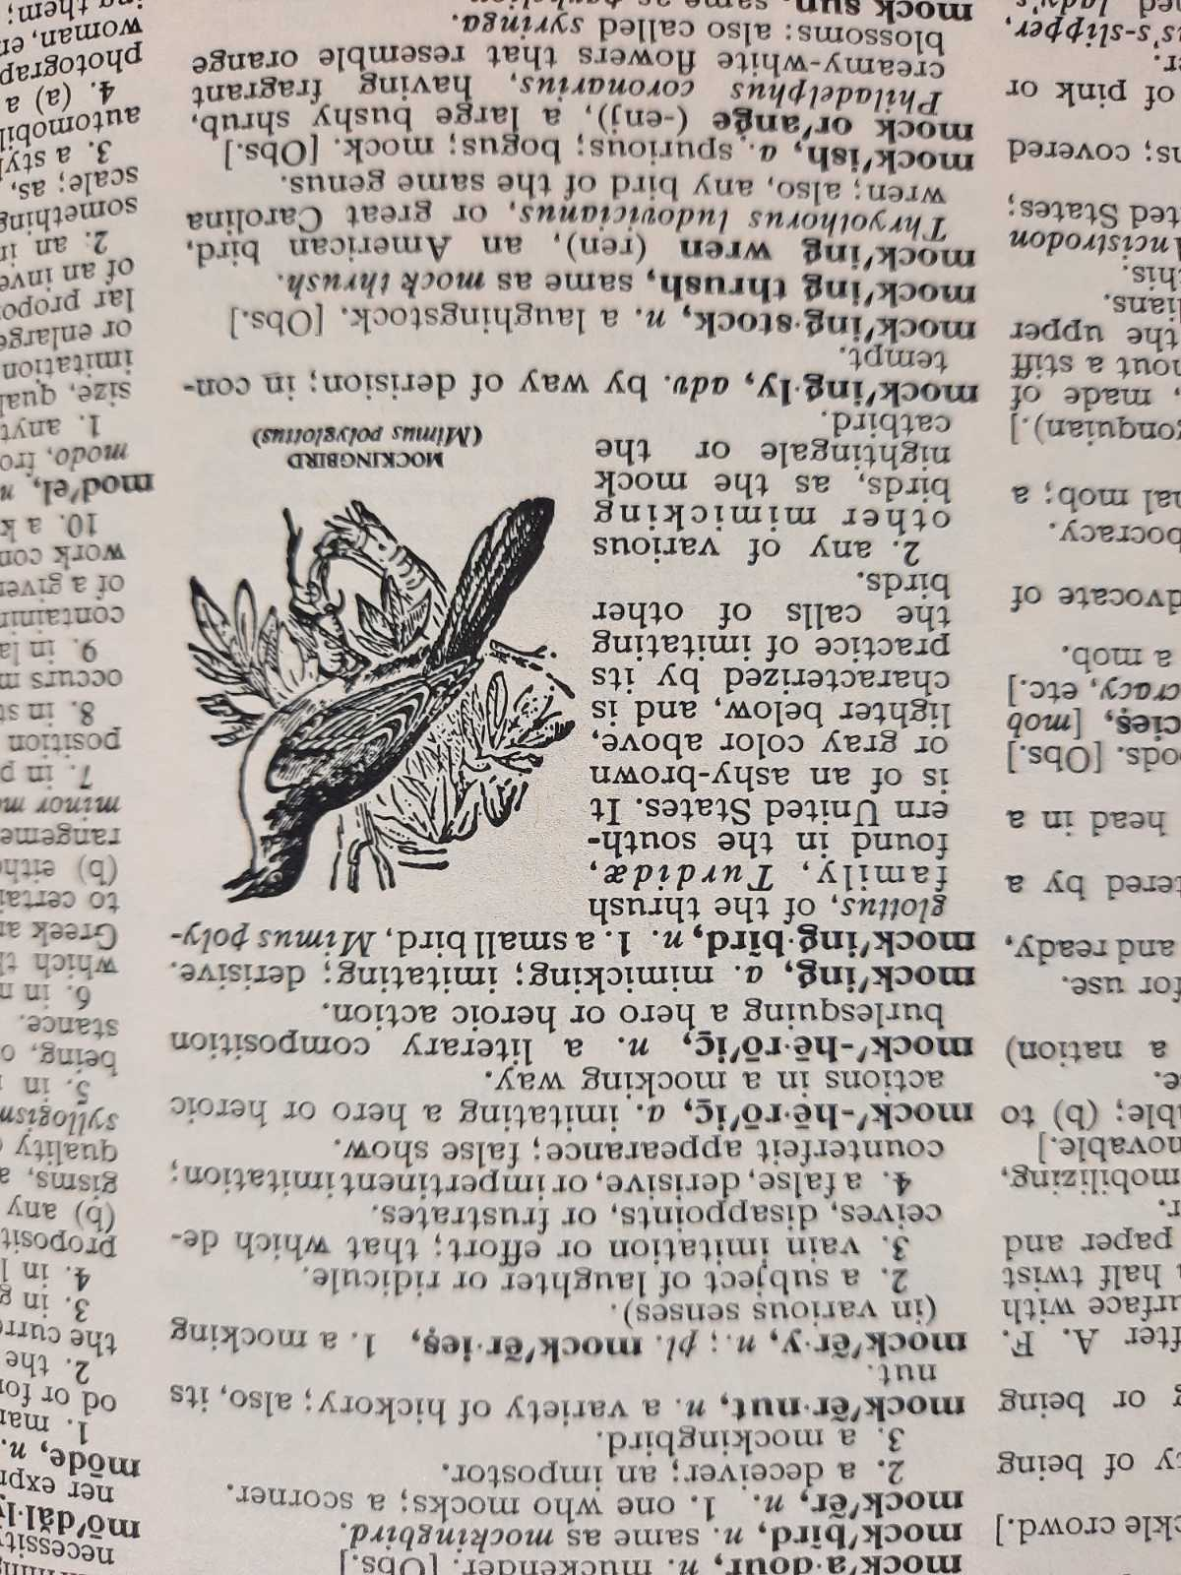
Background
Geospatial data can be extensive and complex, having numerous attributes along with spatial information.
Dictionaries can make it easier to access, manipulate, and analyze this information.
Webster's dictionary
a book alphabetically listing the words and their meanings
Notes:
Geospatial data can be extensive and complex, involving numerous attributes and spatial information. Dictionaries offer efficient data storage and retrieval, allowing you to associate attributes and spatial data with feature IDs. Dictionaries making it easier to access, manipulate, and analyze this information.

Slide 5
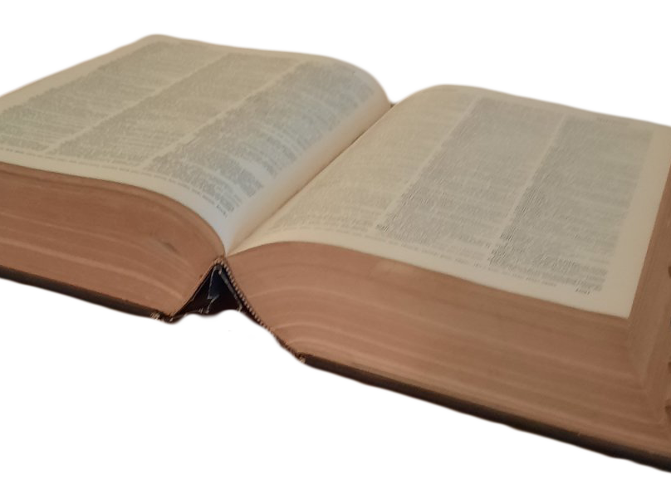
Dictionary
Built-in data type, like strings, tuples, & lists.
A collection of items like lists, but…
Each item is a pair. key:value
myFeature = {'name': 'Lake', 'area': 1000, 'depth': 20}
Each key is unique, like an FID.
Used to store a value with a key & extract the value given the key.

Slide 6
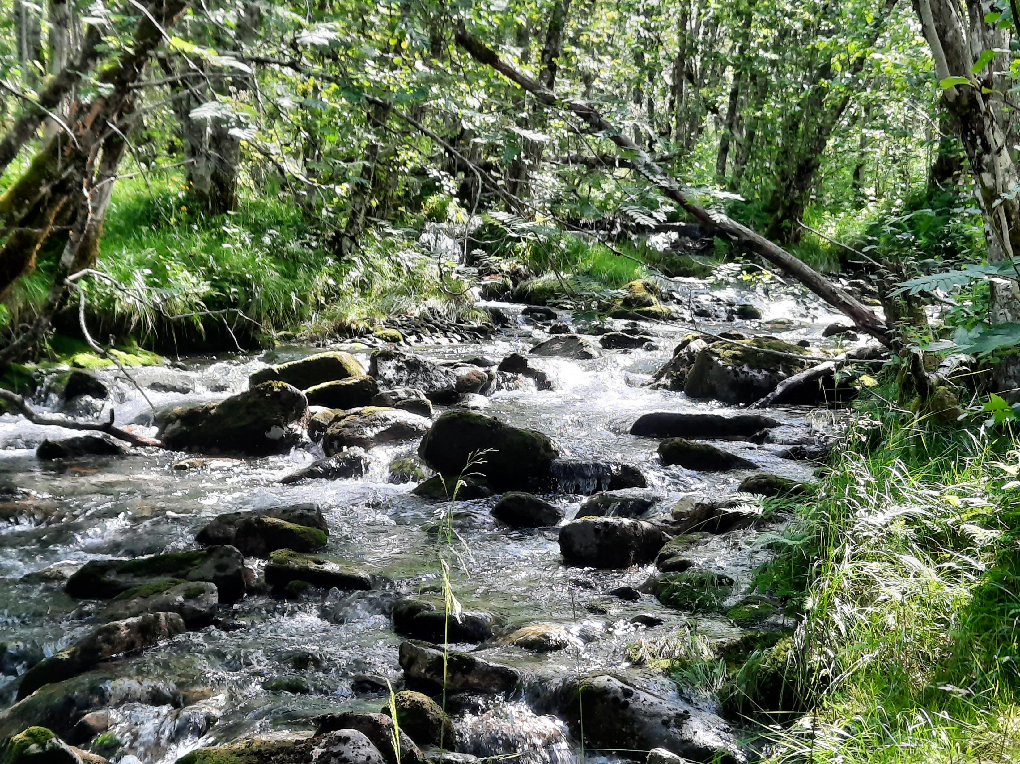
Syntax
Notes:
So how does this all work. Let's get into syntax. Dictionary syntax is similar to list syntax, but there are some important differences. Let's dip back into list syntax to make sure we're all on the same page.

Slide 7

Review – write a line of code for each
Create an empty Python list named mylist.
Append 8 and 5 to your new list.
Set x to the second item in mylist. Use indexing.
Check if 3 is in your list.
Loop through your list and print each item.
Notes:
As a quick refresher, write down a line of code for each of these 5 tasks.
Create an empty list, mylist;
Append 8 and 5 to you new list.
And so forth.

Slide 8
Review – write a line of code for each
Create an empty Python list named mylist. mylist = [ ]
Append 8 and 5 to your new list. mylist.append(8) mylist.append(5)
--or– mylist.extend([8, 5])
Set x to the second item in mylist (use indexing). x = mylist[1]
Check if 3 is in your list. 3 in mylist
Loop through your list and print each item. for item in mylist:
print(item)
Notes:
Create an empty Python list named mylist. mylist = [ ]
Append 8 and 5 to your new list. mylist.append(8) mylist.append(5)
--or– mylist.extend([8, 5])
Set x to the second item in your list by using list indexing. x = mylist[1]
Check if 3 is in your list. 3 in mylist
Loop through your list and print each item. for item in mylist:
print(item)

Slide 9

Review list syntax
Create an empty list
mylist = []
Create a list containing 'Arg', 'Nor', and ‘Lux’
mylist = ['Arg','Nor','Lux']
Add ‘Mar’ to an existing list
mylist.append('Mar')
Remove an instance of ‘Lux’ from the list
mylist.remove('Lux')
Get the third item in the list
x = mylist[2]
Check if 'USA' is in the list
'USA' in mylist
What’s the name for this
type of action?
indexing

Slide 10

Create a dictionary
Create an empty dictionary.
>>> myD = {}
Create a non-empty dictionary.
>>> rivers = {'Nile':6650, 'Amazon':6400, 'Yangtze':6300}
Create a dictionary with items "color":"gray" and "fill":False.
>>> mountain = {'color':'gray', 'fill':False}
items
Notes:
To create an empty dictionary, you use curly braces instead of square braces.
Here's what it looks like to create a dictionary with two items.
Now we know how to create a dictionary

Slide 11


Get the 3rd item's value in the dictionary
>>> cover_dict = {0:"woods", 5:"park", 8:"orch"}
>>> cov1 = cover_dict[2]
There are 3 items in the dictionary… With zero-based indexing, why doesn't this give the 3rd item?
--------------------------------------------------
>>> cov2 = cover_dict[8]
>>> cov2
'orch'
KeyError
Use access-by-key syntax

Slide 12

Access-by-key
Instead of an index, use a key inside square braces.
d[k]
Get the value of the item which has key 5.
>>> cover_dict = {0:"woods", 5:"park", 8:"orch"}
>>> cov = cover_dict[5]
>>> cov
'park'
←access-by-key syntax
# Looks like indexing but it’s NOT

Slide 13
Modify a dictionary*
>>> mountain = {'color': 'gray', 'fill': False}
Add the item "outline":"solid" to mountain (an existing dictionary).
>>> mountain["outline"] = "solid"
>>> mountain
{'color': 'gray', 'fill': False, 'outline': 'solid'}
Modify the color value to blue.
>>> mountain["color"] = "blue"
>>> mountain
{'color': 'blue', 'fill': False, 'outline': 'solid'}
*You can also remove items.
Notes:
Modifying values in a dictionary also uses access by key.

Slide 14
Add item vs . Modify item
>>> mountain = {'color': 'gray', 'fill': False}
Add an item.
>>> mountain["outline"] = "solid"
>>> mountain
{'color': 'gray', 'fill': False, 'outline': 'solid'}
Modify that item.
>>> mountain["outline"] = "dash"
>>> mountain
{'color': 'gray', 'fill': False, 'outline': 'dash'}
Notes:
Adding and modifying look the same!

Slide 15
Check for membership in
Check if soils has an item with a key of 5.
>>> 5 in soils
True
Check if soils has an item with a key of 'Fill'.
>>> 'Fill' in soils
False
Check if soils does not have an item with a key of 4.
>>> 4 not in soils
True
>>> soils = {0:'Fill', 2:'Clay', 5:'Other'}

Slide 16
Dictionary operations
Operation | Explanation
len(d) | Returns the number of items, i.e., the number of (key,value) pairs.
del d[k] | Deletes the key, k, together with its value.
k in d | True, if a key, k, exists in the dictionary d.
k not in d | True, if a key, k, doesn't exist in the dictionary d.
>>> myD = {0:'woods', 5:'park', 8:'orch'}
>>> len(myD)
3
>>> 5 in myD
True
>>> del myD[5]
>>> myD
{0: 'woods', 8: 'orch'}
>>> 5 not in myD
True
>>> len(myD)
2
# Again…not indexing!
For dictionaries always remember to use a KEY in the square braces, not an index.

Slide 17
Ways not to use if, elif
Instead, should be...
if x == 1:
# do stuff
if x == 2:
# do special stuff
if x == 3:
# do another thing
if x == 1:
# do stuff with a
elif x == 2:
# do stuff with b
elif x == 3:
# do stuff with c
elif x == 4:
# do stuff with d
elif x == 5:
# do stuff with e
elif x == 6:
# do stuff with f
…
if x == 1:
# do stuff
elif x == 2
# do special stuff
elif x == 3
# do another thing
Don't use repeated if to check mutually exclusive conditions.
Don't use a large number of elif conditions when consistently testing the same variable’s value and performing the same operation inside.
Instead, should be
using Python
dictionary.

Slide 18
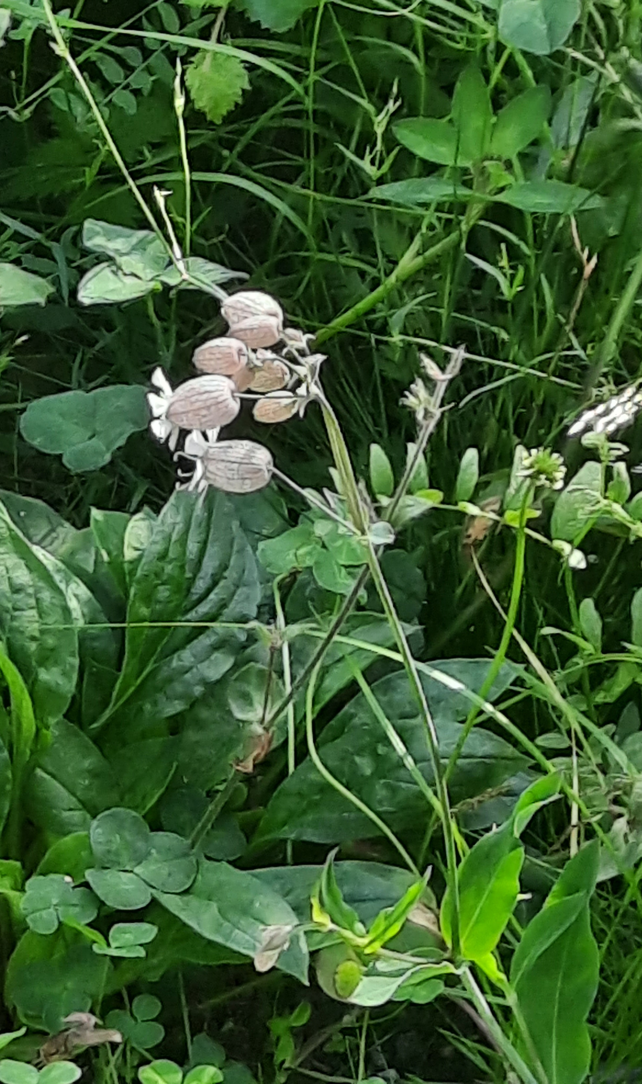
Using a dictionary instead of elif
def plant_watering(plant):
'''Return watering strategy.'''
if plant == "lemon":
water_strategy = "moderate"
elif plant == "blueberry":
water_strategy = "abundant"
elif plant == "pear":
water_strategy = "sparing"
else:
water_strategy = "unknown"
return water_strategy
Notes:
Here we have a function that returns the recommended watering strategy for a given plant type. We get the plant from the caller and use conditional statements to choose the right strategy. This is not so nice because once we add more and more plants and watering strategies, we're going to end up with a whole bunch of if/else conditional tests which becomes difficult to read

Slide 19
Elif replaced with dictionary
def plant_watering(plant):
'''Return plant watering strategy.'''
plant_dict = {"lemon": "moderate",
"blueberry": "abundant",
"pear": "sparing"}
if plant in plant_dict:
water_strategy = plant_dict[plant]
else:
water_strategy = "unknown"
return water_strategy
Notes:
So instead, you can rely on a dictionary to do that mapping for you.

Slide 20
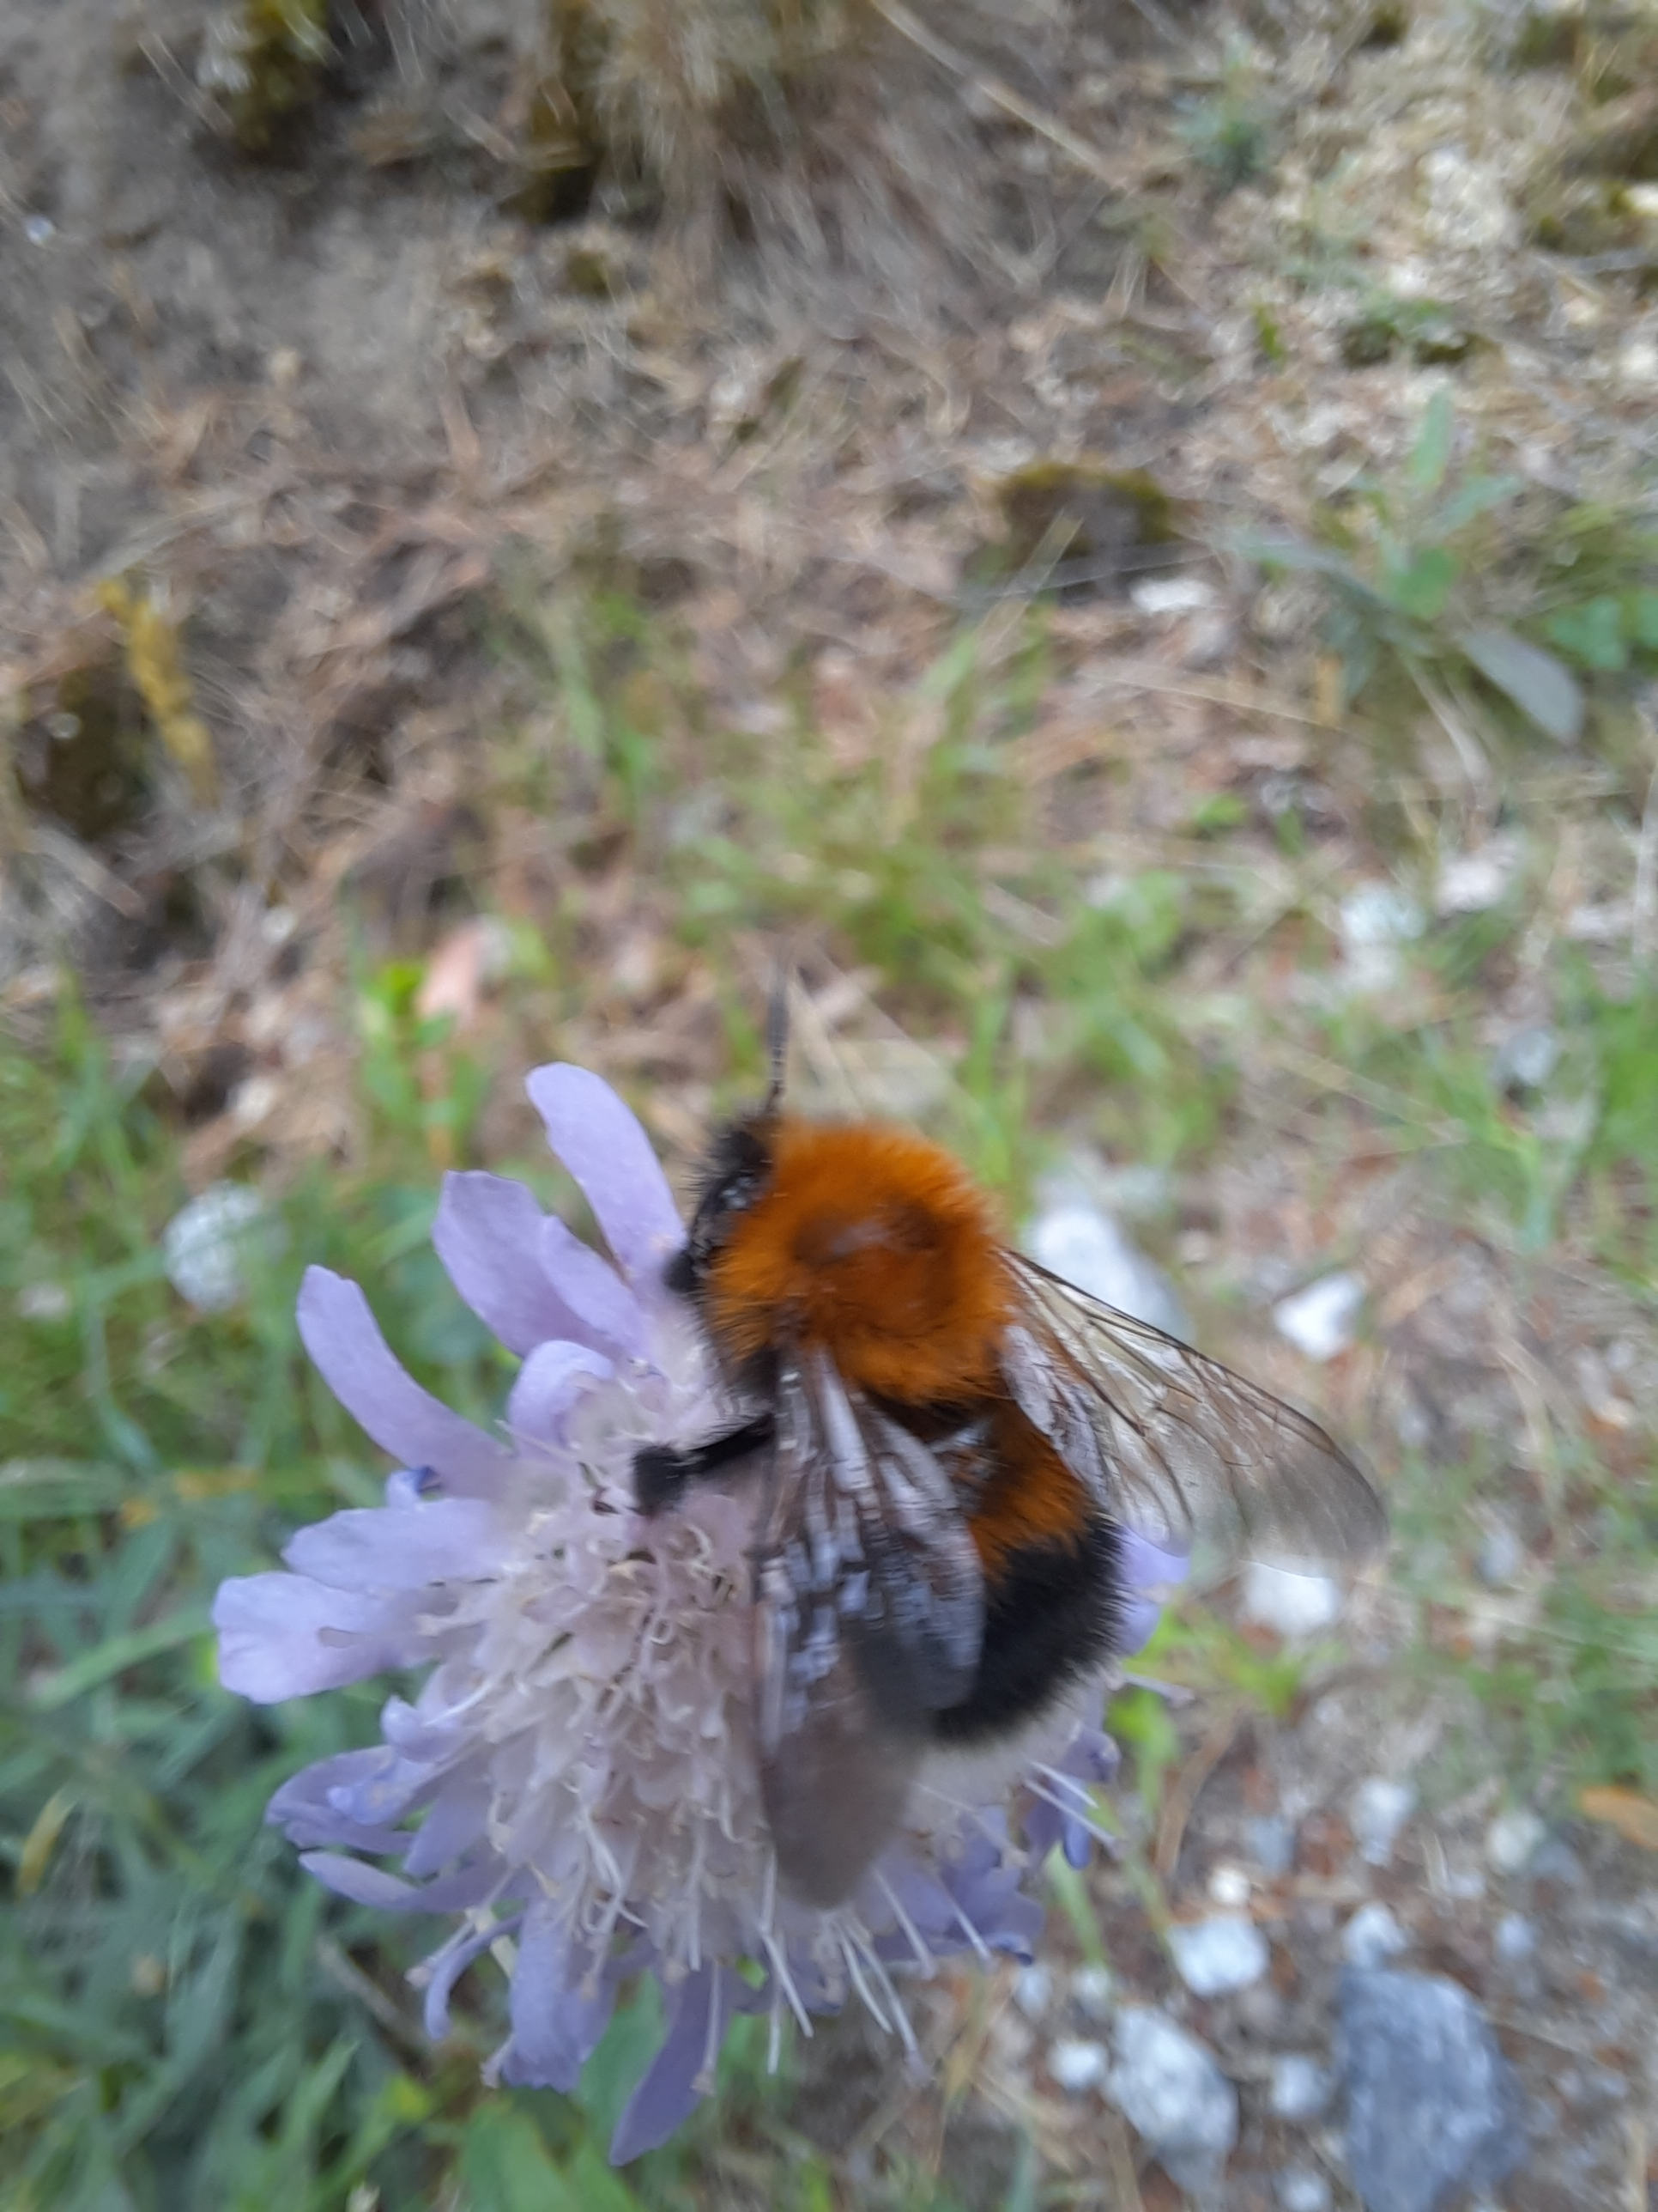
Working with Dictionaries
Create dictionaries
Get items
Set items
Delete items
Access-by key

Slide 21
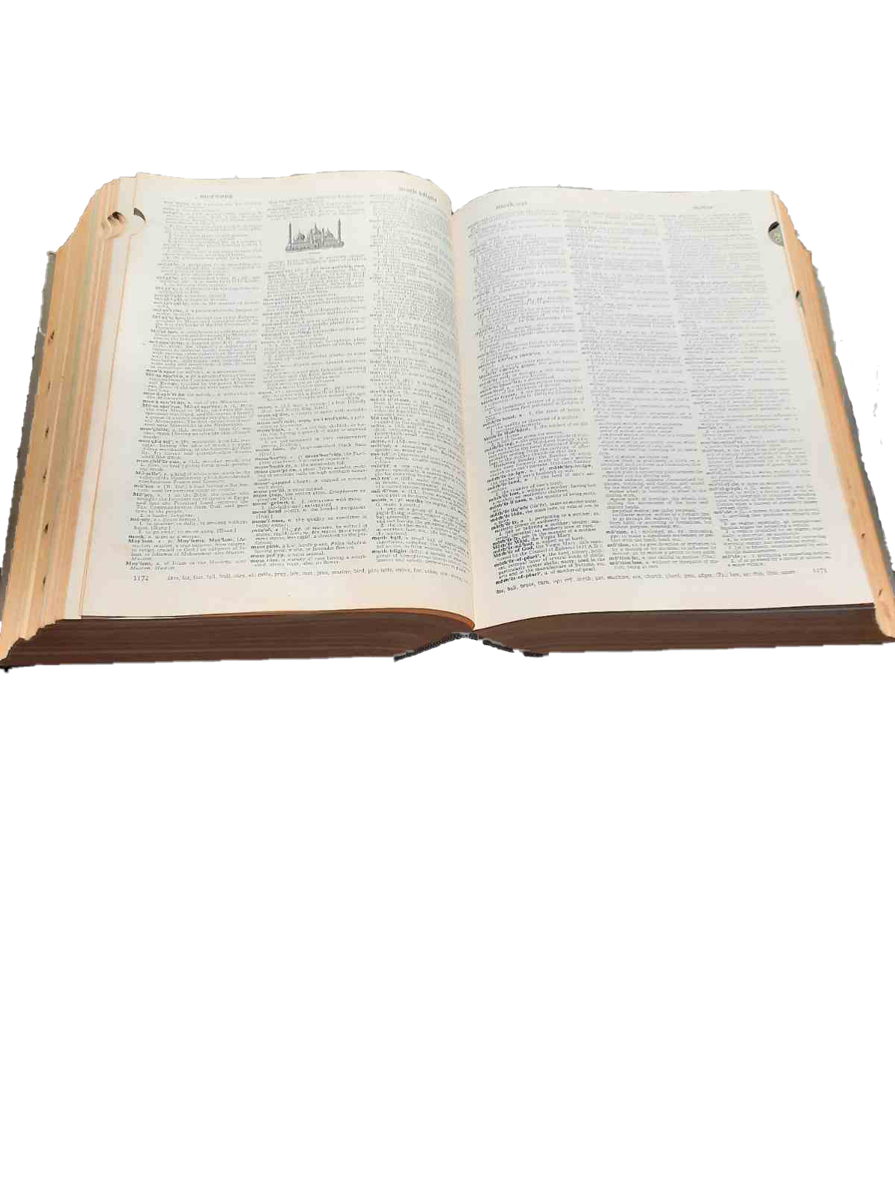
Dictionary methods
Notes:
Like strings and lists, dictionaries have functions that are associated with them.

Slide 22
Dictionary methods
object.method()
Dictionaries methods: clear, copy, fromkeys, get, items, keys, pop, popitem, setdefault, update, values
>>> eyes = {"ant":2, "bee":5, "spider":8}
>>> eyes.pop("spider")
8
>>> eyes
{"ant":2, "bee":5}
>>> eyes.keys()
dict_keys(["ant", "bee"])

Slide 23
Dictionary methods
object.method()
Dictionaries methods: clear, copy, fromkeys, get, items, keys, pop, popitem, setdefault, update, values
>>> eyes = {"ant":2, "bee":5, "spider":8}
>>> eyes.pop("spider")
8
>>> eyes
{"ant":2, "bee":5}
>>> eyes.keys()
dict_keys(["ant", "bee"])
view object

Slide 24
Dictionary methods
object.method()
Dictionaries methods: clear, copy, fromkeys, get, items, keys, pop, popitem, setdefault, update, values
>>> eyes = {"ant":2, "bee":5, "spider":8}
>>> eyes.pop("spider")
8
>>> eyes
{"ant":2, "bee":5}
>>> eyes.keys()
dict_keys(["ant", "bee"])
view object

Slide 25
Dictionary views
Dictionaries methods that return views: keys, values, items
>>> sound = {"lion":"roar", "frog":"croak", "bee":"buzz"}
>>> sound.keys()
dict_keys(['lion', 'frog', 'bee'])
>>> sound.values()
dict_values(['woods', 'park', 'orch’])
>>> sound.items()
dict_items([(0, 'woods'), (5, 'park'), ('foo', 'orch')])
In Python 2.*, keys(), values(), and items() return lists.
In Python 3.*, keys(), values(), and items() return view objects
Views stay synchronized with the dictionary.
Making a view is more efficient than creating a new list whenever these methods are called.

Slide 26
Get list from dict view
To get a list of dictionaries keys, values, or items, cast to list
>>> myD = {0:'woods', 5:'park', 'foo':'orch'}
>>> myD.keys() # keys() returns a view of the keys in the dictionary.
dict_keys([0, 5, 'foo'])
>>> list(myD.keys()) # Returns a list of keys.
[0, 5, 'foo']
>>> list(myD.values()) # Returns a list of values.
['woods', 'park', 'orch']
>>> list(myD.items())# Returns a list of items as key-value tuples.
[(0, 'woods'), (5, 'park'), ('foo', 'orch')]

Slide 27
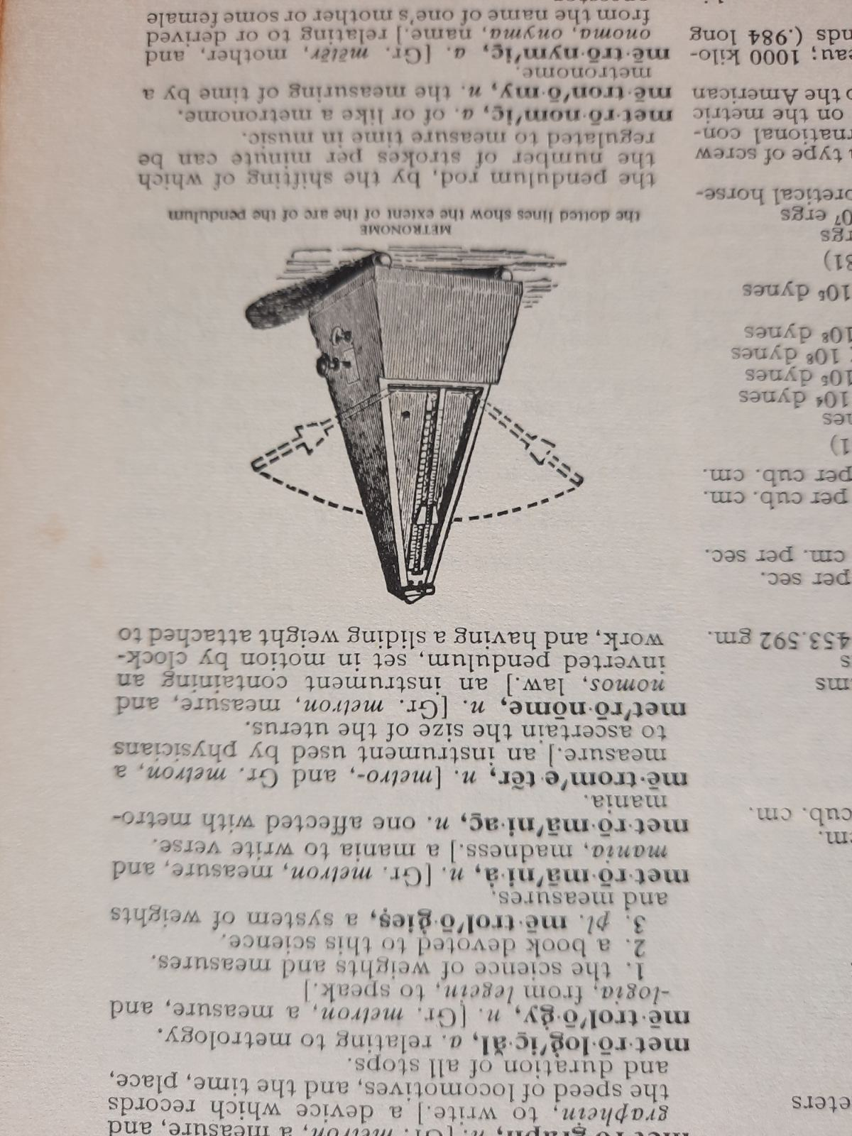
Iterating over keys or values
If you loop over the dictionary, it returns the keys.
>>> myD = {'a':'do', 'b':'re', 'c':'mi'}
>>> for key in myD:
... print(key)
...
a
b
c
To loop over the values, use the values method.
>>> for value in myD.values():
... print(value)
...
do
re
mi

Slide 28

Iterating over dictionary items
To loop over the items, use the items method and two iterating variables.
>>> myD = {'a':'do', 'b':'re', 'c':'mi'}
>>> for key, value in myD.items():
... print(f"The key is {key} and the value is {value}.")
...
The key is a and the value is do.
The key is b and the value is re.
The key is c and the value is mi.

Slide 29
Geospatial Pairs
City Name and Population:
City: Los Angeles
Population: 3,898,747
Feature ID and Geometry:
Feature ID: 12345
Geometry: (POINT (34.0522 -118.2437))
Municipality Name and Admin. Region:
Municipality: New York City
Region: New York State
UTM Zone and Zone Description:
UTM Zone: 33T
Zone Description: UTM Zone 33T, Europe

Slide 30
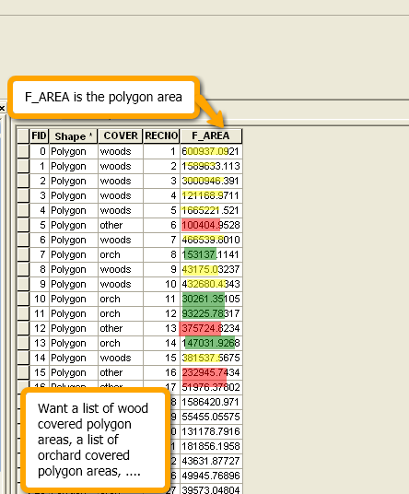
Dictionaries and attribute tables
Can store info. from GIS attribute tables.
Example collect FID:COVER items.
import arcpy
sc = arcpy.da.SearchCursor('park.shp', ['FID', 'COVER'])
myD = {}
for row in sc: ID = row[0] coverType = row[1]
myD[ID] = coverType
del sc
update or modify
Will any dictionary items be modified by this loop?
Notes:
Dictionaries can store in formation from attribute tables. We can use a search cursor to retrieve this information from a table and we can store it for quick access in a dictionary. Here's an example that collects the FID and COVER fields paired up as dictionary items.
We know the format for adding an item to a dictionary is the same as modifying a dictionary element. Will any items be modified by this loop? Will the keys be unique?

Slide 31
Uniqueness of keys
Dictionary of FID:COVER items.
Dictionary of COVER:frequency
Will the FIDs be unique?
Will the COVERs be unique?
If keys are not guaranteed to be unique, may need to use a conditional statement for case “key not in dictionary” to handle this case differently.
Notes:
In the example on the previous

Slide 32
Conditional statement for dictionary creation
Frequency example below:
Collects the frequency of cover types in a dictionary
Each item is coverType:frequency
import arcpy
sc = arcpy.da.SearchCursor('park.shp',
['COVER'])
myD = {}
for row in sc:
key = row[0]
if key not in myD:
myD[key] = 0
myD[key] = myD[key] + 1
del sc
>>> print(myD)
{'woods':9, 'orch':4, 'other':3}
Notes:
>>> print(myD)
{“woods”:9, “orch”:4,”other:3}

Slide 33
Keys and value data types
Keys can only be immutable data types (int, float, string, tuple...)
Values can be any data type (int, float, string, tuple, list, dictionary...)

Slide 34
Keys and value data types
Keys can only be immutable data types (int, float, string, tuple...)
Values can be any data type (int, float, string, tuple, list, dictionary...)

Slide 35
Want a key to store multiple values?
Each key can have only 1 value.
But that value can be a list.
pets = {"dog":["Saint Bernard","Dachshund","Bulldog"],
"cat":["Manx", "Siamese"]}
How to add a new item to the pets dictionary, say, "bird":["Macaw", "Budgie"] ?
pets["bird"] = ["Macaw", "Budgie"]
print(pets)
{'dog': ['Saint Bernard', 'Dachshund', 'Bulldog'],
'cat': ['Manx', 'Siamese'],
'bird': ['Macaw', 'Budgie']}

Slide 36

Modify values that are lists
print(pets)
{'dog': ['Saint Bernard', 'Dachshund', 'Bulldog'],
'cat': ['Manx', 'Siamese'],
'bird': ['Macaw', 'Budgie']}
How to access the cat list?
print(pets["cat"]) ['Manx', 'Siamese']
How to add a new cat (say a Burmese)? Hint: cat's value is a list. How to add to a list?
pets["cat"].append("Burmese")
print(pets)
{'dog': ['Saint Bernard', 'Dachshund', 'Bulldog'], 'cat': ['Manx', 'Siamese'], 'bird': ['Macaw', 'Budgie']}
Use list operations to modify list values in dictionaries.

Slide 37
Add new items with list values
print(pets)
{'dog': ['Saint Bernard', 'Dachshund', 'Bulldog'],
'cat': ['Manx', 'Siamese'],
'bird': ['Macaw', 'Budgie']}
How to add a new pet to the dictionary? We want to include fish, but we don't have any specific fish types yet.
Hint: fish would be a new key and the value will be an empty list for now.
pets["fish"] = []
print(pets)
{'dog': ['Saint Bernard', 'Dachshund', 'Bulldog'], 'cat': ['Manx', 'Siamese'], 'bird': ['Macaw', 'Budgie'], 'fish': []}
Use an empty list if you don't have anything to list yet.

Slide 38
Python lists as dictionary values
Ex.: Dictionary to store COVER types and their areas.
Each item is coverType:listOfAreas
myD = {
'woods': [600937, 1589633,…]
'orch': [153137.114187, …]
'other': [100404, 375724, …]
'park': …
}
myD could be used to calculate statistics about the areas associated with cover types. (mean, std dev, variance, etc.)
To create myD, use a conditional statement…

Slide 39
Using lists as dictionary values
To associate multiple values with a single key, use lists and a condition...
If the key is not yet in the dictionary, set the value to a new empty list.
Either way, append the value to the list.
# IF key not in dict,
# create empty list for that key.
if key not in myD: myD[key] = []
# Append the value to the list.
myD[key].append(value)

Slide 40
Example using lists in a dictionary
Create a dictionary to store COVER types & their areas.
Each item is coverType:listOfAreas
import arcpy
arcpy.env.workspace = 'C:/Temp'
fields = ['COVER', 'F_AREA']
myD = { }
sc = arcpy.da.SearchCursor('park.shp', fields)
for row in sc:
cover = row[0]
area = row[1]
if cover not in myD: # If this cover type is not yet a key in the dictionary,
# create a new empty list.
myD[cover] = []
myD[cover].append(area)
del sc
>>> print(myD)
{'woods': [600937, 1589633,…]
'orch': [153137.114187, …]
'other': [100404, 375724, …]
'park': … }

Slide 41

Summing up
Built-in dictionaries.
Access by key, not by index.
Update/add/delete dictionary items.
Listing keys, values, items.
Dictionaries with looping.
Using dictionaries with arcpy cursors.
Notes:
In general, you now have good sense of how Python dictionaries work, and you can begin to contemplate incorporating them into your geospatial analyses.

Slide 42
Appendix

Slide 43
Add item vs. modify existing item
Dictionary items can be added in 2 ways:
when the dictionary is created:
>>> myD = {0:'woods', 5:'park', 'foo':'orch'}
>>> myD
{0: 'woods', 5: 'park‘, 'foo': 'orch‘}
individually after the dictionary has already been created:
>>> myD[10] = 'lake' # access-by-key syntax
>>> myD
{0: 'woods', 10: 'lake', 'foo': 'orch', 5: 'park'}
Modifying items looks just like #2. Only difference is using a key that is already in the dictionary
>>> myD[5] = 'hurray!' # access-by-key syntax
>>> myD
{0: 'woods', 10: 'lake', 'foo': 'orch', 5: 'hurray!'}

Slide 44
In class – Explore dictionaries
Type statements from the in-class page in the Interactive Window and answer the questions.
What does myD2 = {} do?
Explain the difference between what happened when you typed myD[1] = "other" and when you typed myD[3] = "lake".
Explain the difference between myList[2] and myD[2].
Write a line of code to add an item with key "London" and value "Heathrow" into myD.
Write a line of code to add an item with key "beer" and value ["Bass", "Corona", "Dunkle"] to myD.
Write a line of code to append "Pale Ale" list whose key is "beer".
Set the value of x to "5 hrs". Write a line of code to add an item with key "sleep" and value a list containing one item, x. (solutions in note view)
Notes:
Creates an empty dictionary named myD2.
Before these commands, the dictionary looked like this myD = {0:"woods", 1:"park", 5:"orch"}
myD[1] = "other" modified the item which has key 1 myD[3] = "lake” added a new item to the dictionary.
myList[2] is indexing into a list. It returns the 3rd item in the list. myD[2] returns the value of the dictionary item with key of 2. But this dictionary doesn’t have one, so it returns an error.
myD[“London”] = “Heathrow”
myD[“beer”] = ["Bass", "Corona", "Dunkle"]
myD[“beer”].append(“Pale Ale”)
x = “5 hrs” myD[“sleep”] = [x]

Slide 45
In class – on a piece of paper…
Create a dictionary where the keys are 3 classmates and the values are their favorite beverage.
Iterate through the keys in the dictionary, printing them
Iterate through the keys in the dictionary, printing the key and the value
bevD = {“Tim”:“Sambucus”, “Paul”:“Red Bull”, “Rahul”:”vodka”}
#One solution
for person in bevD:
print(person)
for person in bevD:
print(person, bevD[person])
#Another solution
for person in bevD.keys():
print(person)
for person, drink in bevD.items():
print(person, drink)

Slide 46
DrinkDict.py
Create a dictionary where drinks are the key and a list of people who favor that drink are the value, by completing the code in the given script. The existing code uses the built-in raw_input function to prompt you for 10 people's names and favorite drinks. Example output:
{ ‘tea’: [’Lani‘, ’Josh‘], ’water‘: [’Stew‘, ‘Mike’], 'beer': [’Ginger', ’Steph', ’Latonia', ’Brendan'], 'sweet tea': [’Brian', ’Steph']
}
myD={}
for i in range(10):
name = raw_input("Name:")
drink = raw_input(name +"'s fav. drink:")
# insert dictionary code here.

Slide 47
DrinkDict.py solution
d={}
for i in range(10):
name = raw_input("Name:")
drink = raw_input(name +"'s fav. drink:")
if drink in d:
d[drink].append(name)
else:
d[drink] = [name]

Slide 48
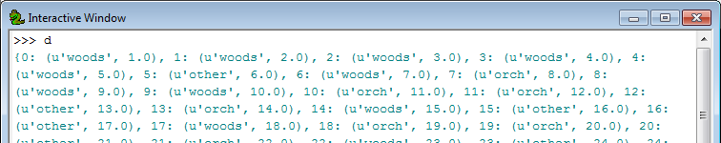
In class - table2dict.py
Create a search cursor for shapefiles.
Build a dictionary with FID as the key and a tuple of the non-shape fields as the value.
Dictionary item format is uniqueID: (field1,field2, …)
Example input ‘COVER63p.shp’ has output:

Slide 49
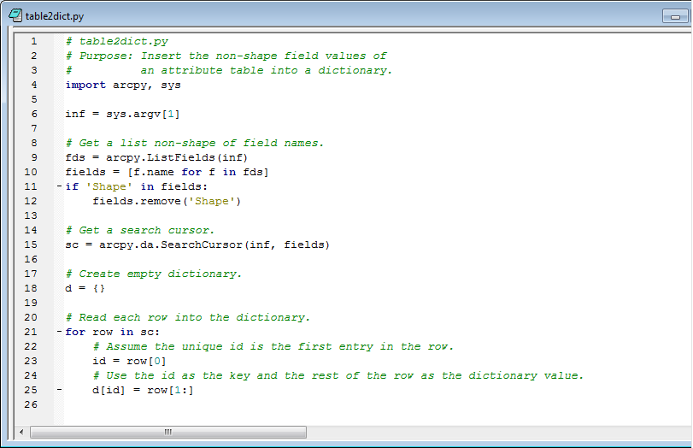
table2dict.py

